Slide 1
ScanFi – The WiFi Locator

Slide 2

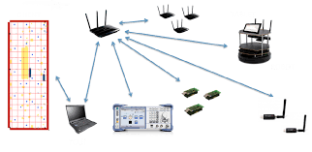
Why Wifi for localisation?
The present localisation systems (GPS) do not work precisely for indoor conditions.
Lot of noise and too weak strength to use GPS data for indoor purposes.
Thus, there is a requirement for other modes of indoor localisation.

Slide 3
Existing methods of Indoor Localisation
Bluetooth Low Energy Beacons
Wifi – ToA/TDoA based approach
Wifi – RSSI based approach
This approach relies on collecting radio fingerprints by mobile devices. BLE beacon technology relies on synchronous data communication between Tx and Rx.
This approach requires designing antenna arrays and measuring the phase difference between different receivers based on their ToA/TDoA.
High Power/Accuracy
Complex design
Synchronous operation
This approach uses the wifi signal strength to estimate the location of the transmitter.
Low Power/Accuracy
Simple design
No Sync between Tx and Rx required.

Slide 4
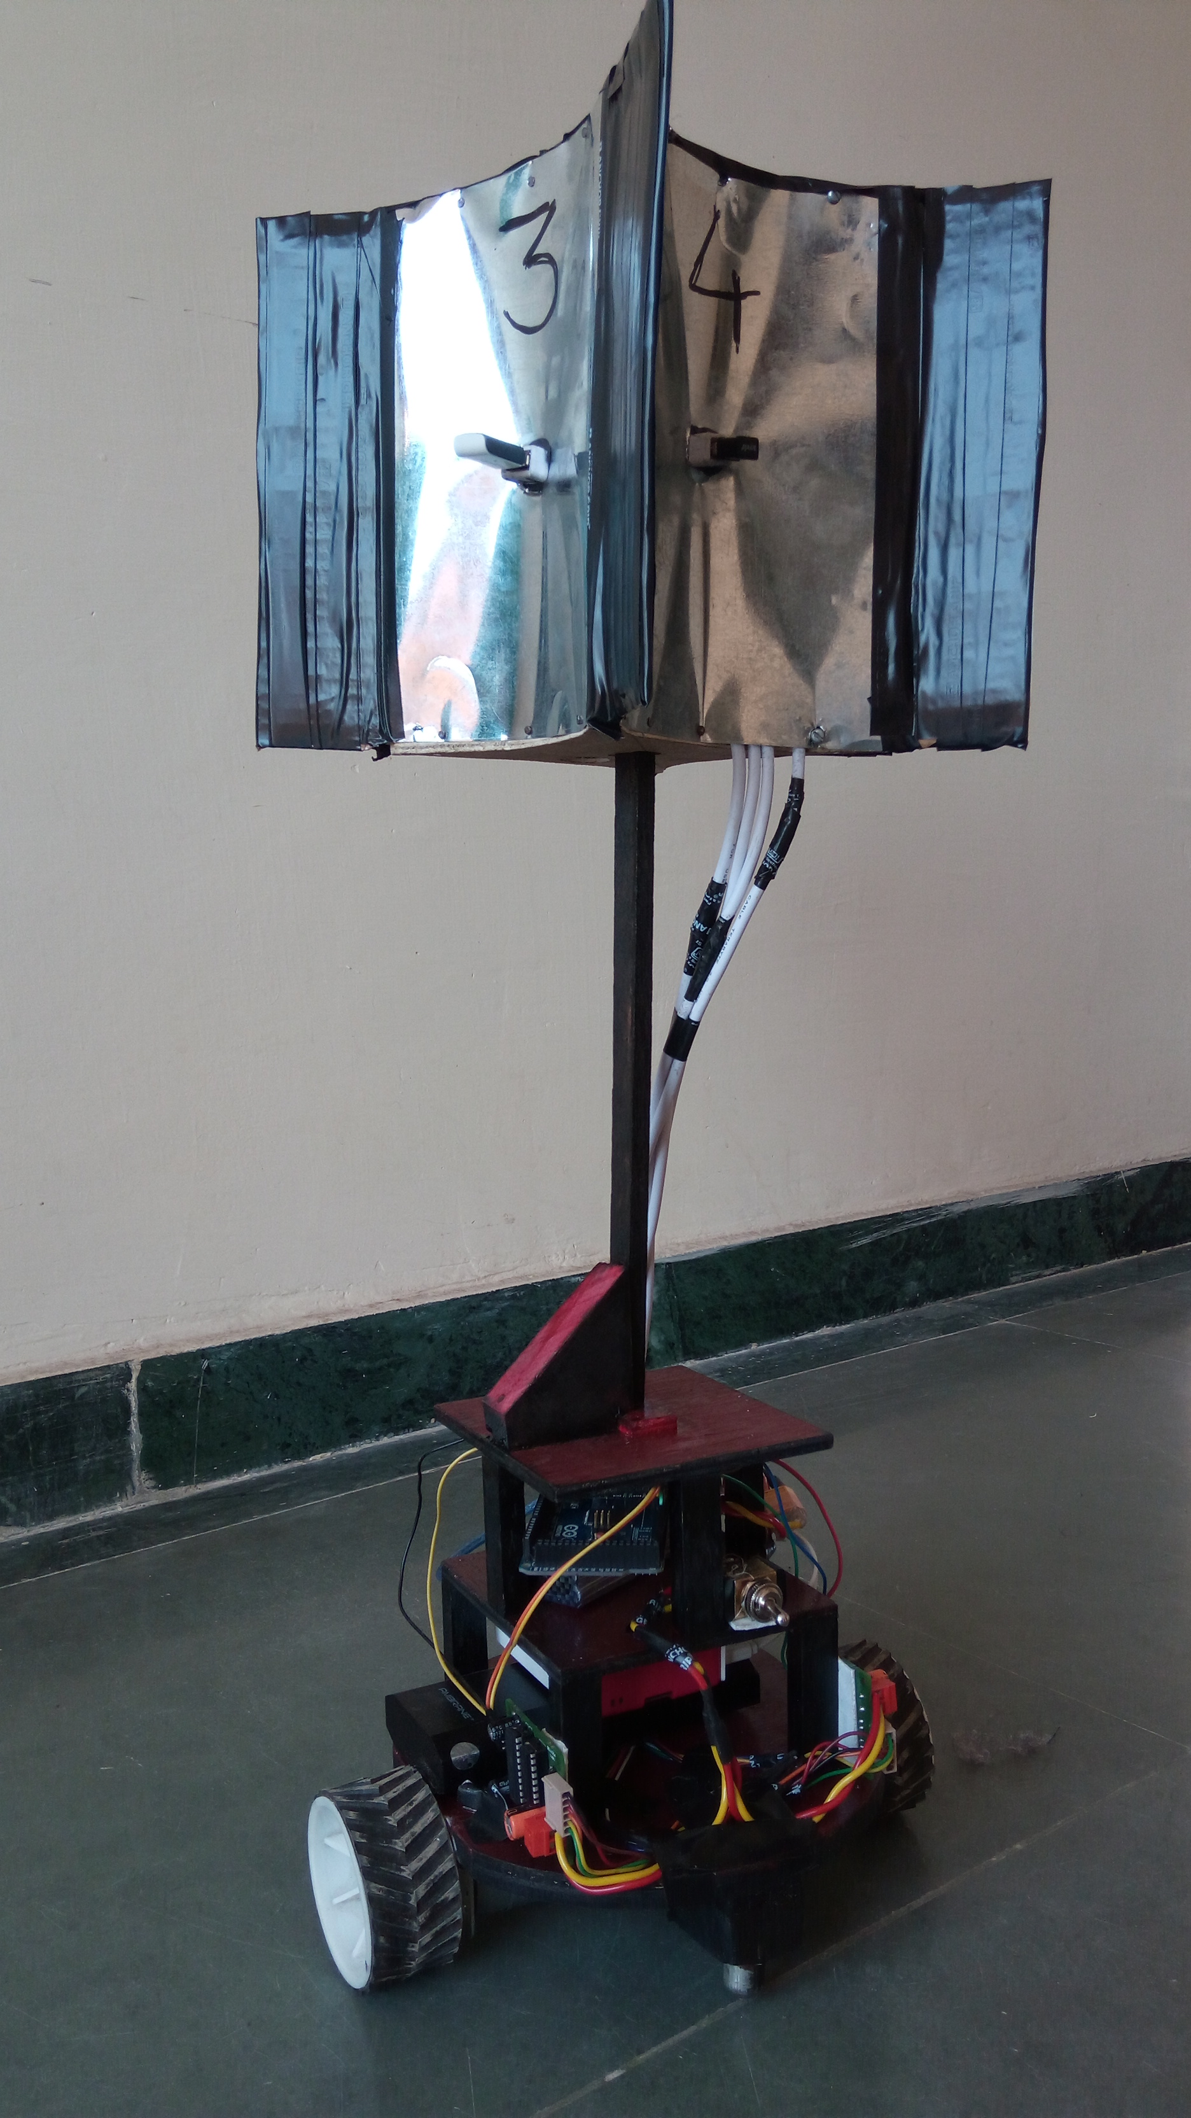
The solution
An innovative architecture

Slide 5
The Design approach
Step 1
Step 2
Step 3
Mathematical Modelling
The Problem statement was simulated on MATLAB for modelling of RSSI of a Wifi transmitter and various path planning algorithms were tested.
Hardware Design
Fabricated Wifi receiver designs corresponding to the different path planning algorithms including single reciever & multiple reciever models.
Embedded System Design
Examining all required functionality for the robot and adopting best possible electronics available in the market.

Slide 6
Mathematical Modelling And Path Planning
Developed and simulated a suitable path loss model (on MATLAB) to calculate the Received Signal Strength Index (RSSI), keeping in mind the indoor environments.
Simulations were done to generate near – real life conditions, keeping in mind the constraints such as quantized values of RSSI and additive noise.
Path-Planning was done by implementing stochastic gradient descent adaptive filter or the Least Mean Squared algorithm to minimise the least mean square of the error signal.

Slide 7
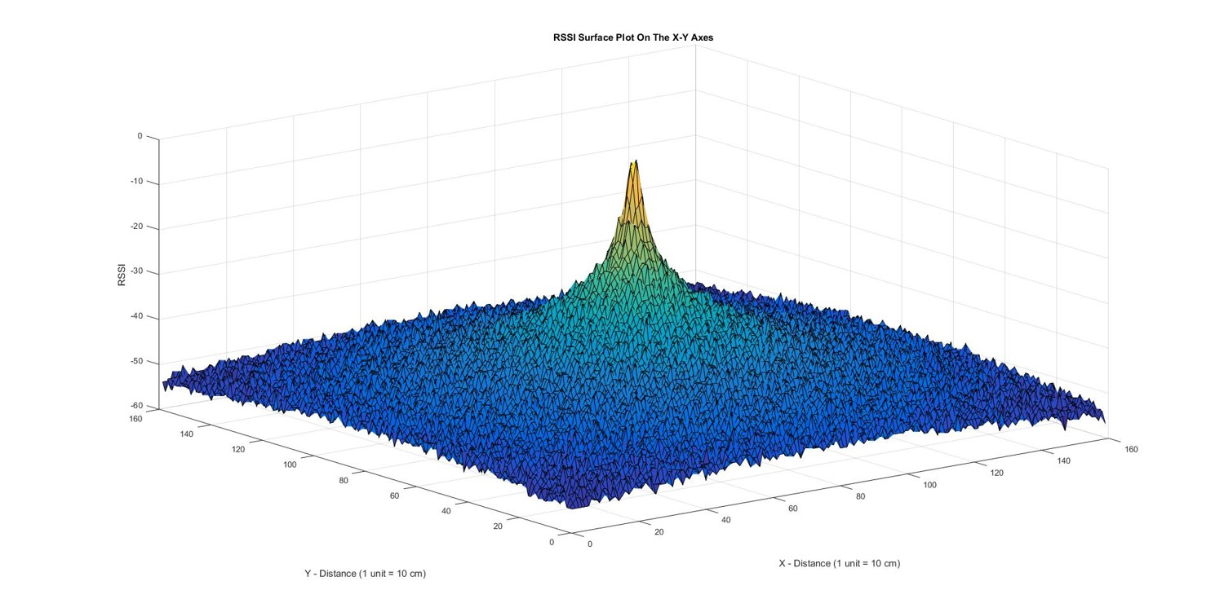

Slide 8
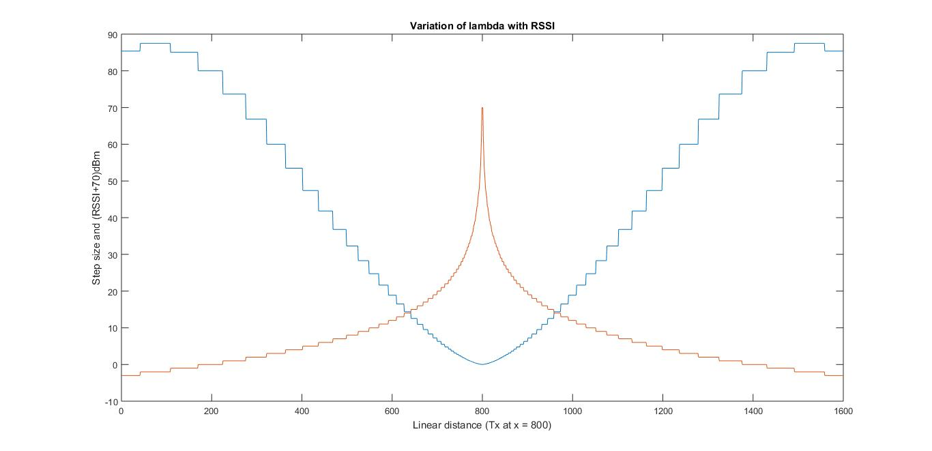

Slide 9
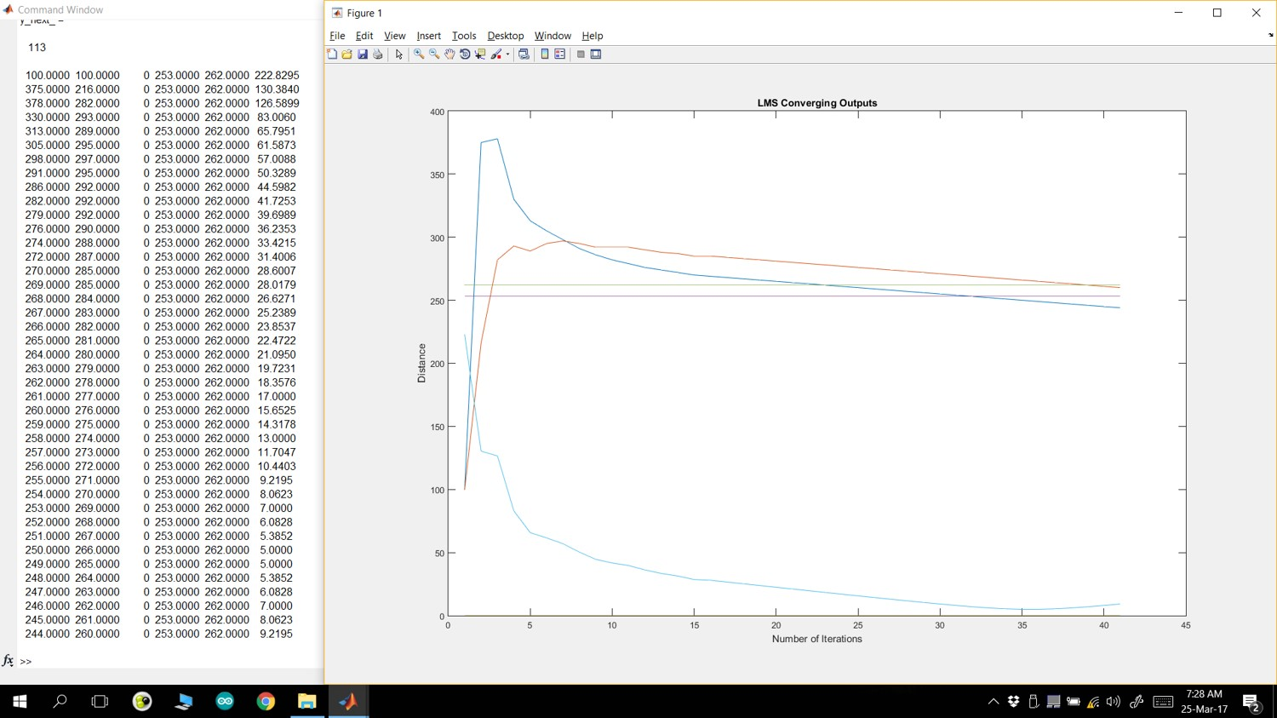
RSSI Model Used: $−10n\log_{10}{d+c}$

Slide 10

Mechanical Design
Chassis and Receiver Design

Slide 11
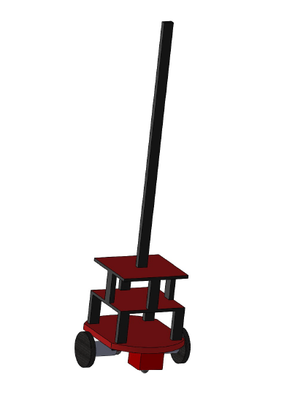
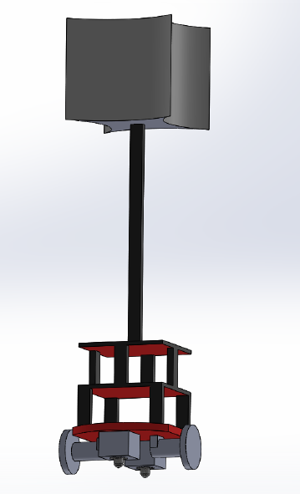
Chassis Designs
Single Receiver Design
Multiple Receiver Design

Slide 12
Mechanical Design
The size of the bot was kept small keeping in mind the accuracy of 50 cm.
Base of the bot is circular to provide symmetry.
A differential drive mechanism with two inline DC motors with encoders has been employed.
Receiver Module Designs:
The single antenna system
The multiple antenna system

Slide 13
Advantages/Drawbacks of the designs
The single antenna system
(i) Easy to design and interface with the hardware.
(ii) Single Wi-Fi receiver unable to accurately record and analyze RSSI values due to their inherent noisy nature .
(iii) The path planning algorithms are iterative and follow a gradient descent approach to locate the transmitter.
(iv) Approaches used: Perpendicular probing, Least Mean Square.
(v) NOT Robust !

Slide 14
Advantages/Drawbacks of the designs
The Multiple antenna system
(i) Employs a four-way hull on top of the bot with WiFi receivers on each sides.
(ii) Facilitates Line of sight (LoS) communication between some receivers and the transmitter while attenuating the signal strength for other receivers.
(iii) The path planning algorithms are simplistic and easy to implement compared to single antenna model.
(iv) Provides directional information about the transmitter in addition to the RSSI value.
(v) Fairly Robust and tolerant to noisy environments.

Slide 15
Embedded System
Components & Design

Slide 16
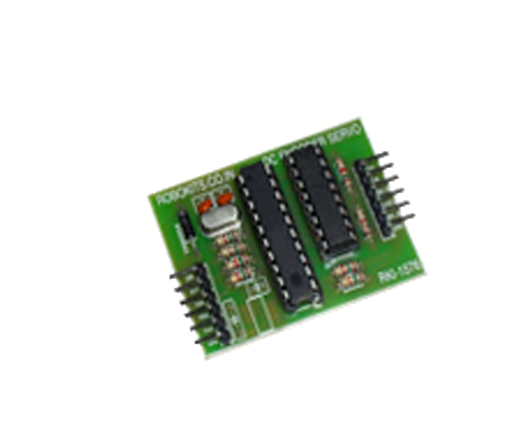
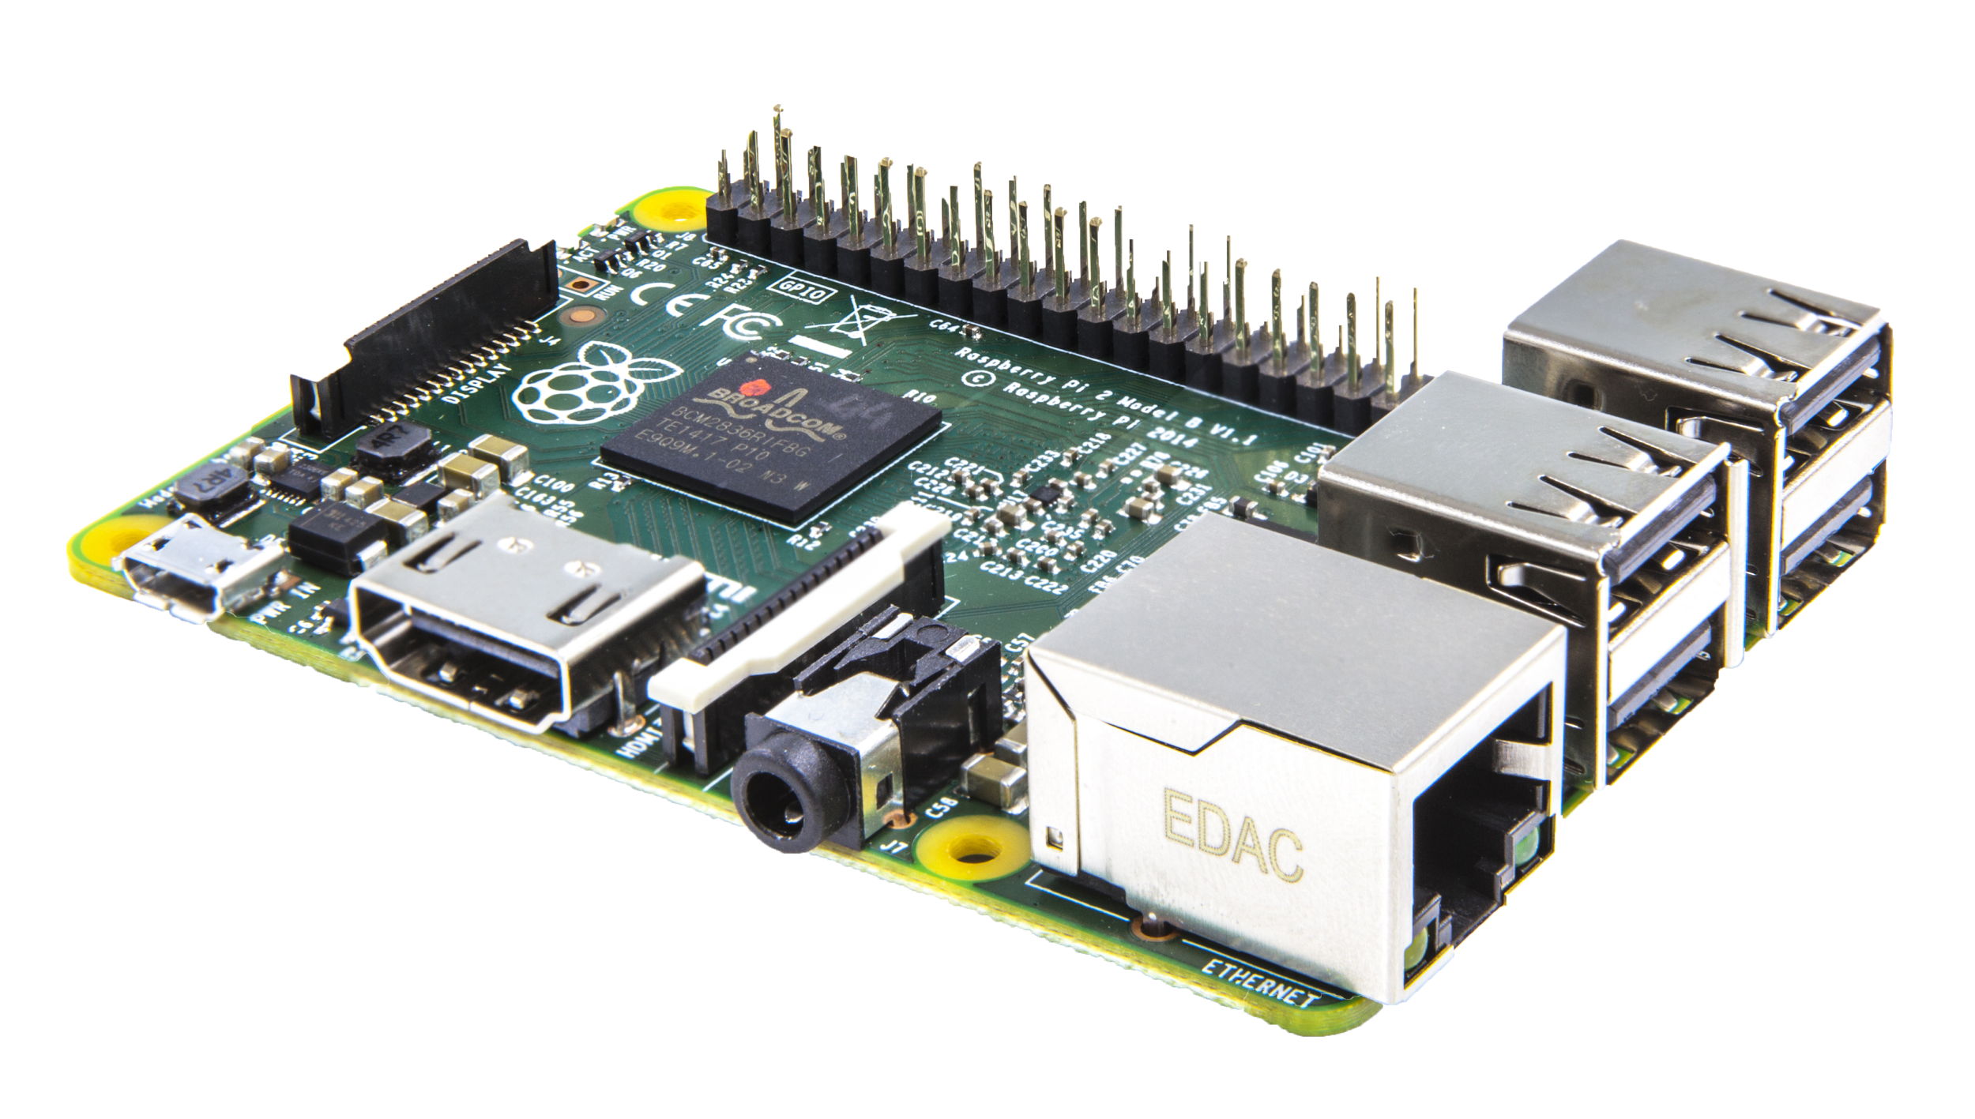
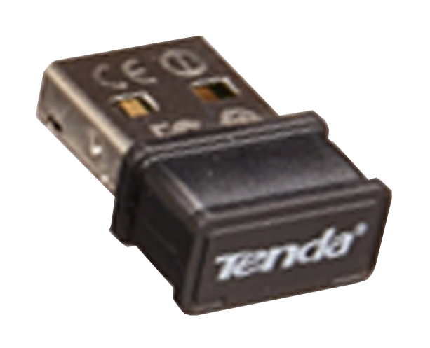
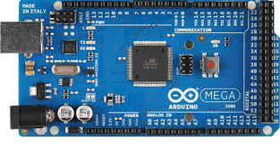
Why these?
Raspberry Pi 3 – High Level Controller
Arduino Mega – Low Level Controller
Tenda W311MI
Serial DC encoder Driver
1 GB RAM
4 USB ports
Ethernet Connectivity
Powerful on-board computer
4 Serial Ports
256KB Flash
Small and Cheap
Easy USB connectivity
Easy connectivity
Signal coverage upto 9 metres
Cheap and easily availabe
Wide driver supply range (7V to 12V)
Serial converter to Arduino
PID on Position Control

Slide 17
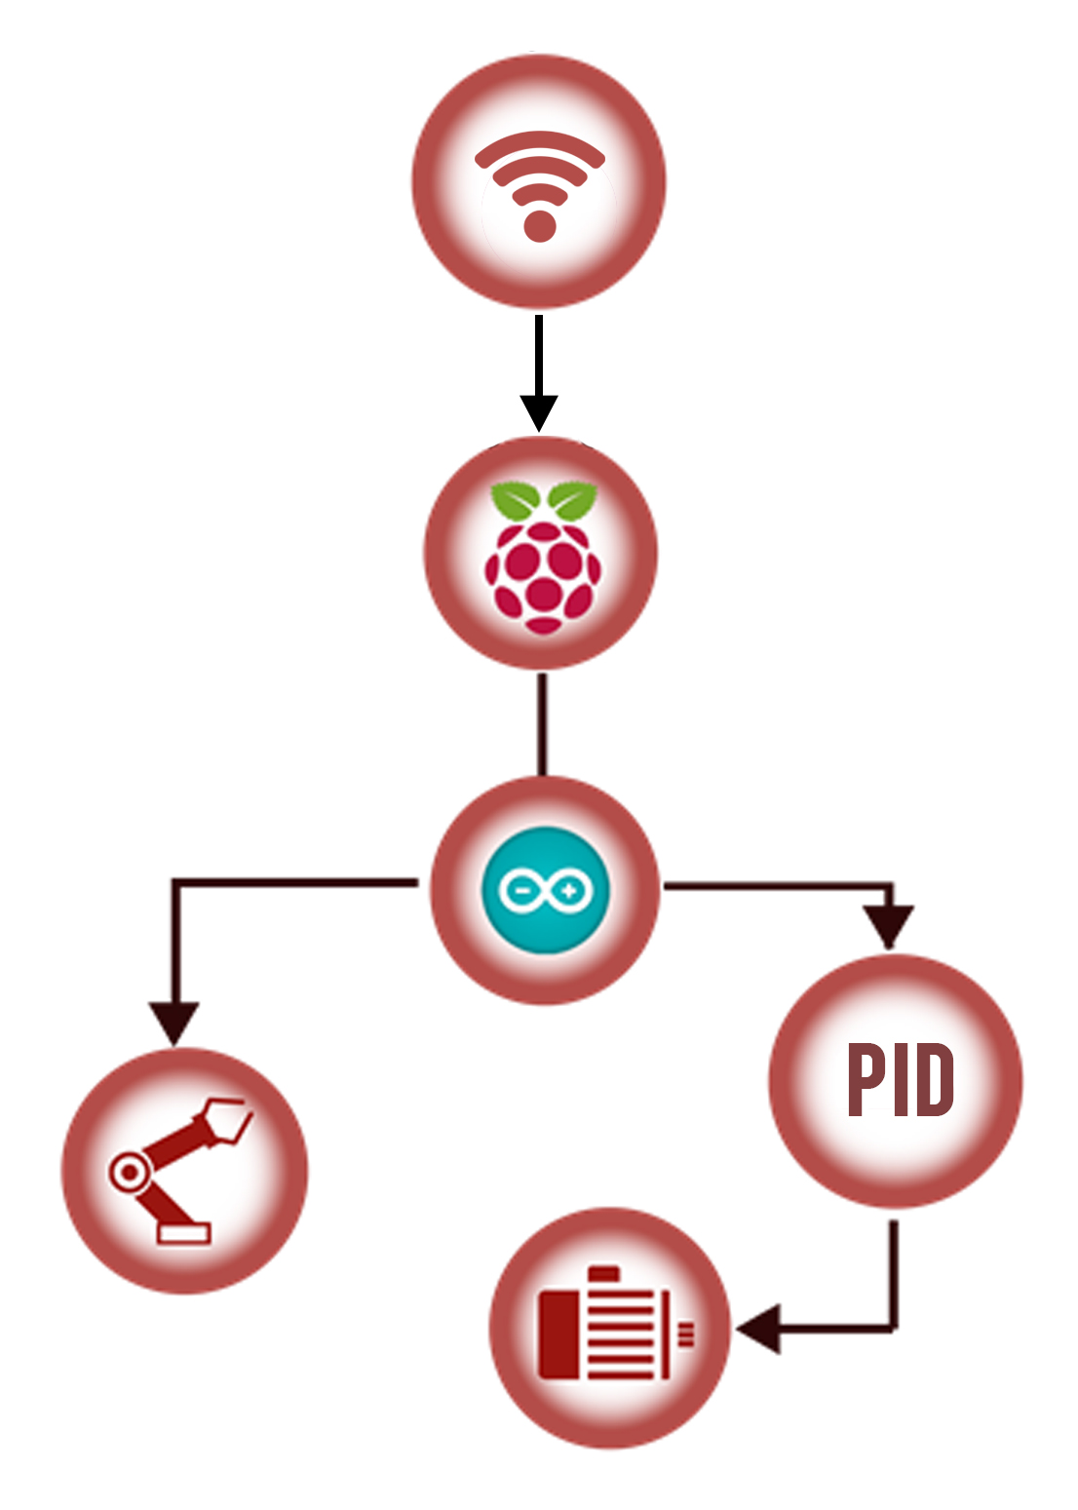
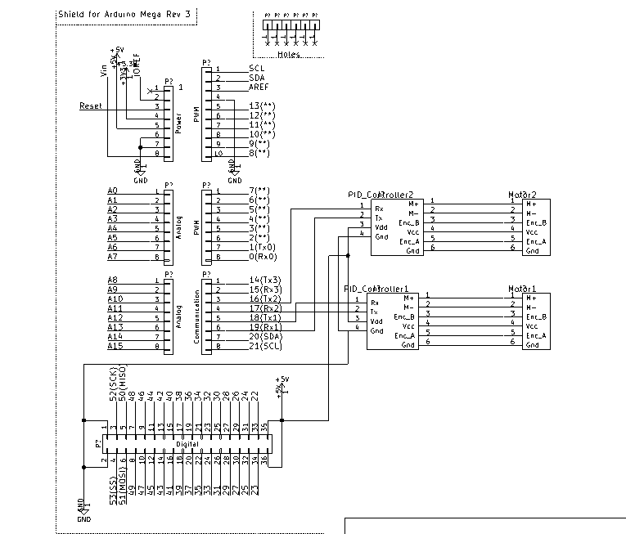
System Architecture

Slide 18
High level Controller
The High level control is implemented on a Raspberry Pi 3 pocket computer.
The algorithm employs an angular probing approach recording RSSI values of all 4 receivers and determining the optimal direction of motion.
This process is repeated and the distance to move is determined as a decreasing function of the current RSSI value.
The robot stops on reaching at a distance with a particular threshold of RSSI value.

Slide 19
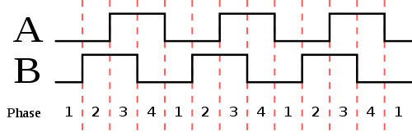
Low level Controller
Robot control is coded on Arduino Mega which receives commands over serial communication from Raspberry Pi.
The PID controller has been employed on position control of the motors to navigate the robot precisely.
The controller receives commands from Arduino through UART communication.

Slide 20
Cost Analysis
COMPONENT | QUANTITY | COST
Raspberry Pi 3 | 1 | Rs 2900
Arduino Mega | 1 | Rs 750
DC encoder Motors | 2 | Rs 3500
Wifi Adapters | 4 | Rs 1400
Power Bank | 1 | Rs 600
Battery | 1 | Rs 1400
Chassis | - | Rs 500
Total |  | Rs 11,050

Slide 21
Thank You

Slide 22
Questions

